Slide 1
Progress

Slide 2
Importance of Early Diagnosis
Early diagnosis of Alcohol-Related Liver Disease (ARLD) and Non-Alcoholic Steatohepatitis (NASH) is crucial due to their significant health impacts and potential for severe progression.
Alcohol-Related Liver Disease (ARLD):
Prevalence and Mortality: Globally, ARLD affects approximately 4.8% of the population. The overall mortality rate among those with ARLD is 23.9%, with liver-related mortality at 21.6%. BMC Public Health
Rising Trends: Recent data indicates a concerning increase in alcohol-related liver transplants, especially among young adults and women. This shift highlights the growing impact of alcohol misuse in demographics not traditionally seen at high risk. New York Post
Non-Alcoholic Steatohepatitis (NASH):
Prevalence: NASH, a severe form of non-alcoholic fatty liver disease, affects about 1.5% to 6.5% of the global population. Its prevalence is increasing, paralleling the rise in obesity and metabolic syndrome. PubMed
Progression and Mortality: NASH can progress to cirrhosis and liver cancer. Studies have shown that individuals with NASH have higher liver-related mortality compared to those with simple steatosis. PubMed
Importance of Early Diagnosis:
Preventing Disease Progression: Identifying ARLD and NASH in their early stages allows for interventions that can halt or even reverse disease progression. Lifestyle modifications, such as reducing alcohol intake for ARLD and implementing dietary changes and exercise for NASH, are more effective when initiated early.
Reducing Healthcare Burden: Early diagnosis and management can decrease the need for advanced treatments, such as liver transplants, thereby reducing healthcare costs and improving patient quality of life.
In summary, early detection of ARLD and NASH is vital to implement effective interventions, prevent severe liver damage, and address the growing public health challenges posed by these diseases.

Slide 3
Our Project
We did RNA-Seq analysis to discover new biomarkers which can be used for early diagnosis of liver diseases.
RNA-seq (RNA sequencing) is a technique used to study the RNA in a sample to understand gene expression. It allows researchers to measure how much RNA is present in a cell or tissue at a specific time and condition, revealing which genes are active and how much they are expressed.

Slide 4
Here's a simple breakdown for RNA-Seq Analysis:
RNA Extraction: First, RNA is extracted from cells or tissues.
Conversion to cDNA: The RNA is then converted into complementary DNA (cDNA) because DNA is more stable and easier to analyze than RNA.
Sequencing: The cDNA is sequenced using high-throughput sequencing technology to produce millions of short DNA reads.
Analysis: The sequence data is mapped back to a reference genome, and the levels of gene expression are determined based on how often each gene is represented in the sequencing data.
Our project covers only the last step of RNA-Seq Analysis.

Slide 5
We got the data from Cem Kuscu -Ph.D., Assistant Professor in the Department of Surgery at the University of Tennessee Health Science Center- to analyze them with bioinformatic tools.

Slide 6
Collecting Samples
Liver samples were collected from liver transplant surgery patients with the assistance of Dr. Cem Kuscu UTHSC
The collection was conducted under approved ethical guidelines and with informed consent from all participants.

Slide 7
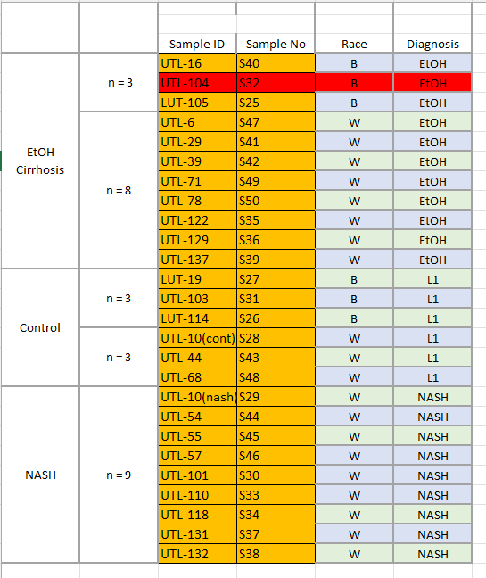
Samples included 10 patients with ethanol-induced liver disease (EtOH), 9 patients with non-alcoholic steatohepatitis (NASH), and 6 healthy control individuals.

Slide 8
RNA-Seq Procedure
Sample Preservation
After collection, the tissue samples were immediately preserved using RNA Later solution (ThermoFisher AM7020) to maintain RNA integrity. After 24 hours in RNA Later, the samples were frozen at -80°C for long-term storage until RNA extraction.
RNA Isolation
Total RNA was extracted from the frozen liver tissues using the Zymo Direct-zol RNA Miniprep Kit (R2050), following the manufacturer’s protocol. An on-column DNase I treatment was performed to remove any contaminating genomic DNA. The extracted RNA was quantified using a NanoDrop Spectrophotometer, and the quality was assessed using an Agilent 2100 Bioanalyzer to ensure high-quality RNA suitable for downstream sequencing applications.
RNA Library Preparation
The library preparation was conducted using the NEBNext® Ultra™ II RNA Library Prep Kit for Illumina® (NEB #7775), according to the manufacturer's protocol. For each sample, 500 ng of total RNA was used, and mRNA was enriched using poly(A) magnetic beads. After mRNA enrichment, reverse transcription was performed to generate cDNA, which was then prepared for sequencing.
The resulting cDNA libraries were pooled equimolarly to a final concen-tration of 4 nM.
Each library was checked for quality using the Agilent Bioanalyzer, and the size distribution was confirmed to be in the appropriate range for Illumina sequencing.
Sequencing
The pooled cDNA libraries were sequenced on an Illumina HiSeq plat-form at the Oklahoma Medical Research Foundation (OMRF). Paired-end sequencing was performed with 150 bp read lengths, generating an average of 20 million reads per sample. The sequencing facility demultiplexed the raw data, providing individual FASTQ files for each sample.

Slide 9
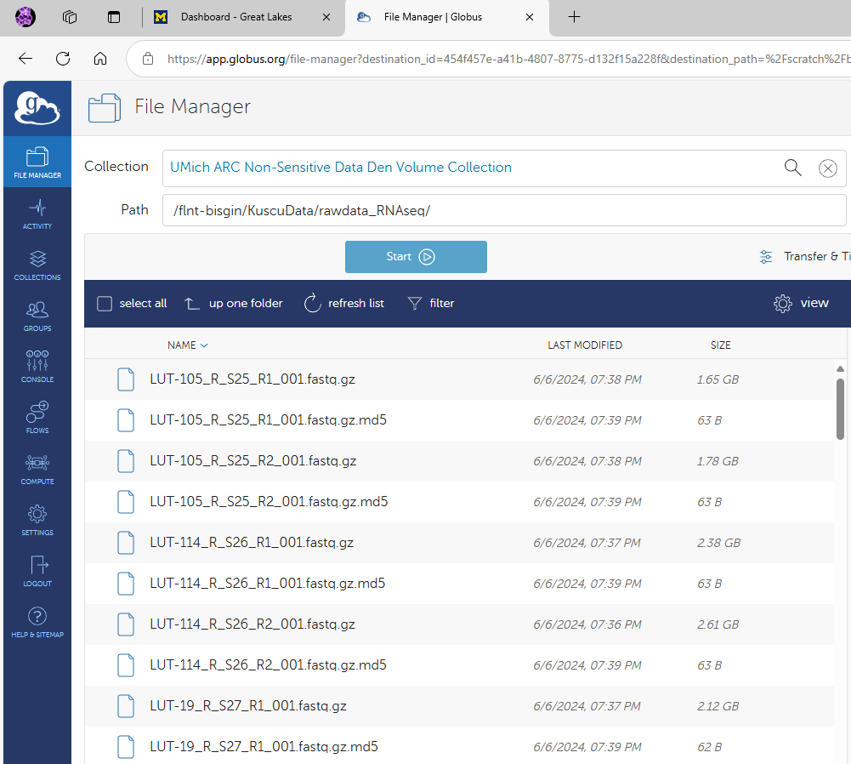
RNA-Seq Analysis
The FASTQ files used in this study were obtained using Halil Bisgin's Globus account. Halil Bisgin is an Associate Professor of Computer Science, College of Innovation and Technology, The University of Michigan-Flint.

Slide 10
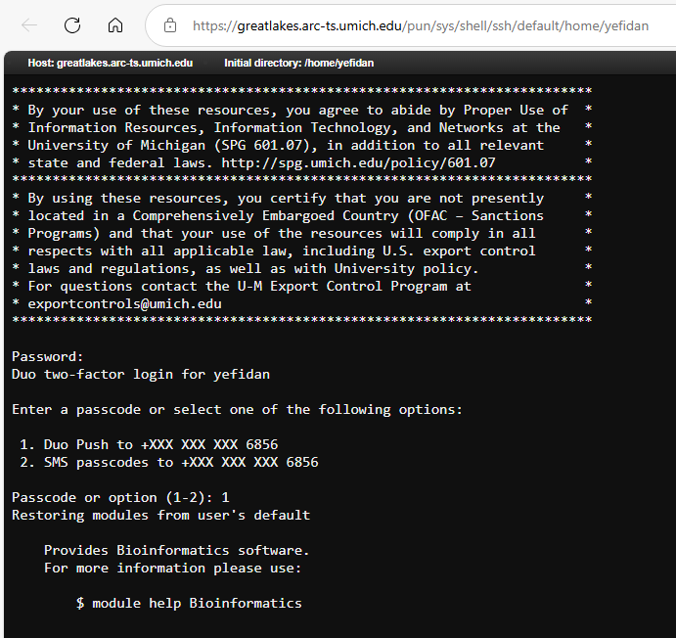
RNA-Seq Analysis - Globus
The first steps of analysis which require super-computer for computations were done at Globus shell which was provided to Yesim Fidan (our supervisor) by Dr. Halil Bisgin.

Slide 11
RNA-Seq Analysis – Globus
We started with loading necessary modules
module load Bioinformatics
module load star/2.7.11a-hdp2onj
module load multiqc/1.22.2
module load samtools/1.13-fwwss5n
module load subread/2.0.3
module save

Slide 12
Then we created the necessary directories to save our output files.
mkdir -p fastq # includes fastq files
mkdir -p ref
mkdir -p aligned_data
mkdir -p fastqc_results
mkdir -p star_index
mkdir -p alignment_qc
mkdir -p counts

Slide 13
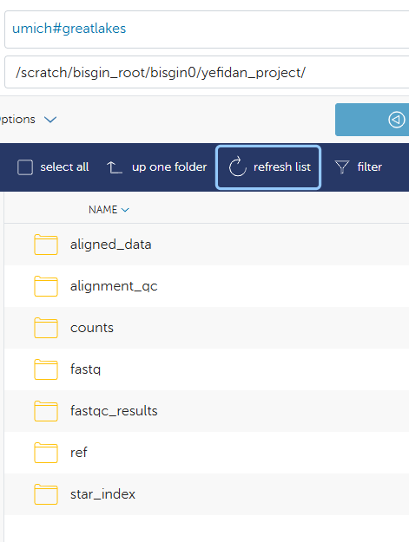

Slide 14
Then we downloaded reference genome and annotation files
A reference genome file is a text file that contains the complete DNA sequence of a healthy member of a specie’s genome. It serves as a reference to compare genomic data, like RNA-seq, to identify differences cases and controls.
wget -P ref https://ftp.ensembl.org/pub/release-112/fasta/homo_sapiens/dna/Homo_sapiens.GRCh38.dna_sm.primary_assembly.fa.gz
An annotation file contains information about the locations of genes, regulatory regions, and other important features within a reference genome.
wget -P ref https://ftp.ensembl.org/pub/release-112/gtf/homo_sapiens/Homo_sapiens.GRCh38.112.gtf.gz
# Unzip the downloaded files
gunzip ref/Homo_sapiens.GRCh38.dna_sm.primary_assembly.fa.gz
gunzip ref/Homo_sapiens.GRCh38.112.gtf.gz

Slide 15
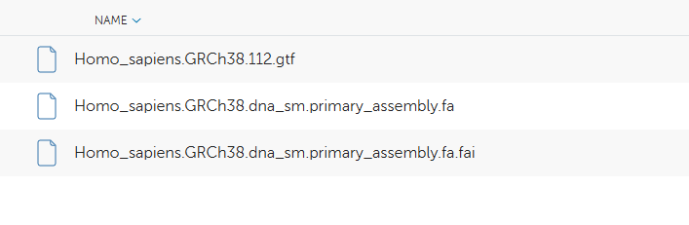

Slide 16
Then we did FastQC Analysis. That step helped us to understand the quality of fastq files which were sent. Any problem during the fastq file generation can be detected by this analysis and low-quality sequenced samples can be adjusted or removed to maintain high accuracy in further analysis.
fastq_dir="fastq"
fastqc_output="fastqc_results"
fastqc -t 8 -o $fastqc_output $fastq_dir/*.fastq.gz
multiqc $fastqc_output -o $fastqc_output

Slide 17
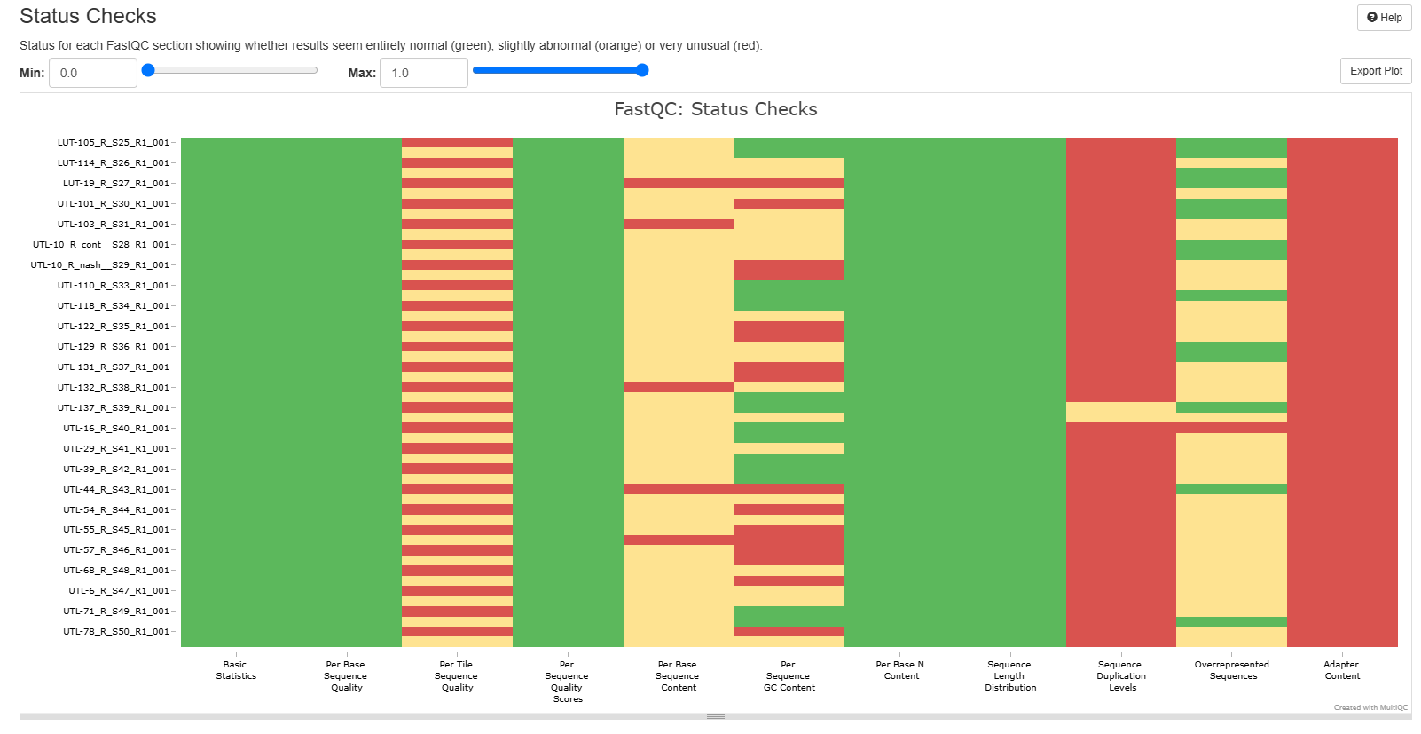

Slide 18
Then we trimmed the samples to improve their quality by eliminating some low quality information and we did FastQC Analysis of Trimmed Files
trim_galore --paired --quality 20 --length 36 --stringency 5 --fastqc --output_dir trimmed_fastq fastq/*.fastq.gz
fastqc -t 8 -o trimmed_fastqc_results/ trimmed_fastq/*.fq.gz
multiqc trimmed_fastqc_results/ -o trimmed_fastqc_results/

Slide 19
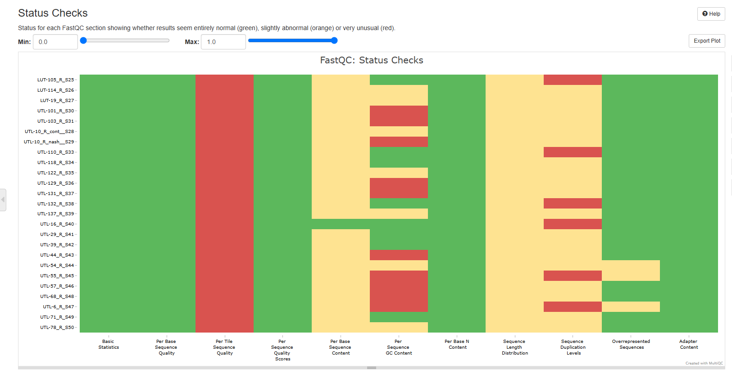

Slide 20
Then we generated Genome Index by STAR. Generating a genome index is the process of creating a reference map that allows a software tool to quickly locate parts of a genome when comparing sequences.
(Think of it like creating a table of contents for a large book. Instead of reading the entire book every time you need information, you can just look at the table of contents to quickly find what you're looking for. In genomics, the genome index lets the software quickly find where specific parts of a genome (like genes or sequences) are located in the reference genome, making sequence alignment faster and more efficient.)
STAR --runMode genomeGenerate --genomeDir star_index --genomeFastaFiles ref/Homo_sapiens.GRCh38.dna_sm.primary_assembly.fa --sjdbGTFfile ref/Homo_sapiens.GRCh38.112.gtf --runThreadN 16

Slide 21
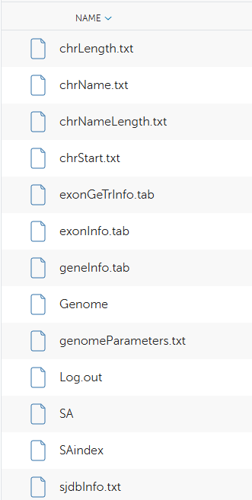

Slide 22
Then we did the alignment with STAR. Alignment is the process of matching our RNA sequences (called reads) to a reference genome. The goal is to figure out where each read comes from in the genome so we can understand its origin, helping us analyze genes, mutations, or expression levels.
for sample in $(ls trimmed_fastq/*_R*_001_val_1.fq.gz | sed 's/_R[0-9]_001_val_1.fq.gz//' | sed 's/trimmed_fastq\///'); do
STAR --runThreadN 16 --genomeDir star_index --readFilesIn trimmed_fastq/${sample}_R1_001_val_1.fq.gz trimmed_fastq/${sample}_R2_001_val_2.fq.gz --readFilesCommand zcat --outFileNamePrefix aligned_data/${sample}_ --outSAMtype BAM SortedByCoordinate
done

Slide 23
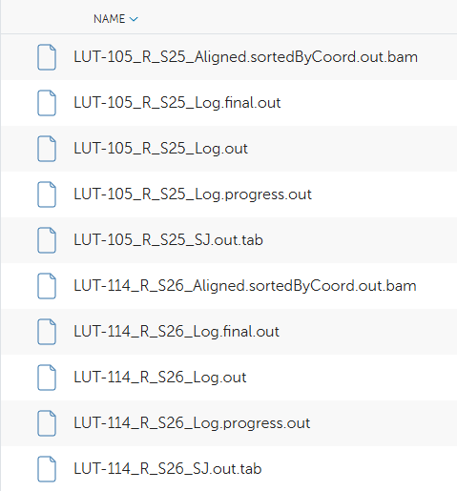

Slide 24
Then we did Quality Control of Alignment. Quality control (QC) of alignment in bioinformatics refers to the process of ensuring RNA-seq data correctly and accurately aligned (fit) to a reference genome and assigned (fit) to functional components in the reference genome.
for bam_file in aligned_data/*.bam; do
samtools flagstat $bam_file > alignment_qc/$(basename $bam_file .bam)_flagstat.txt
done

Slide 25
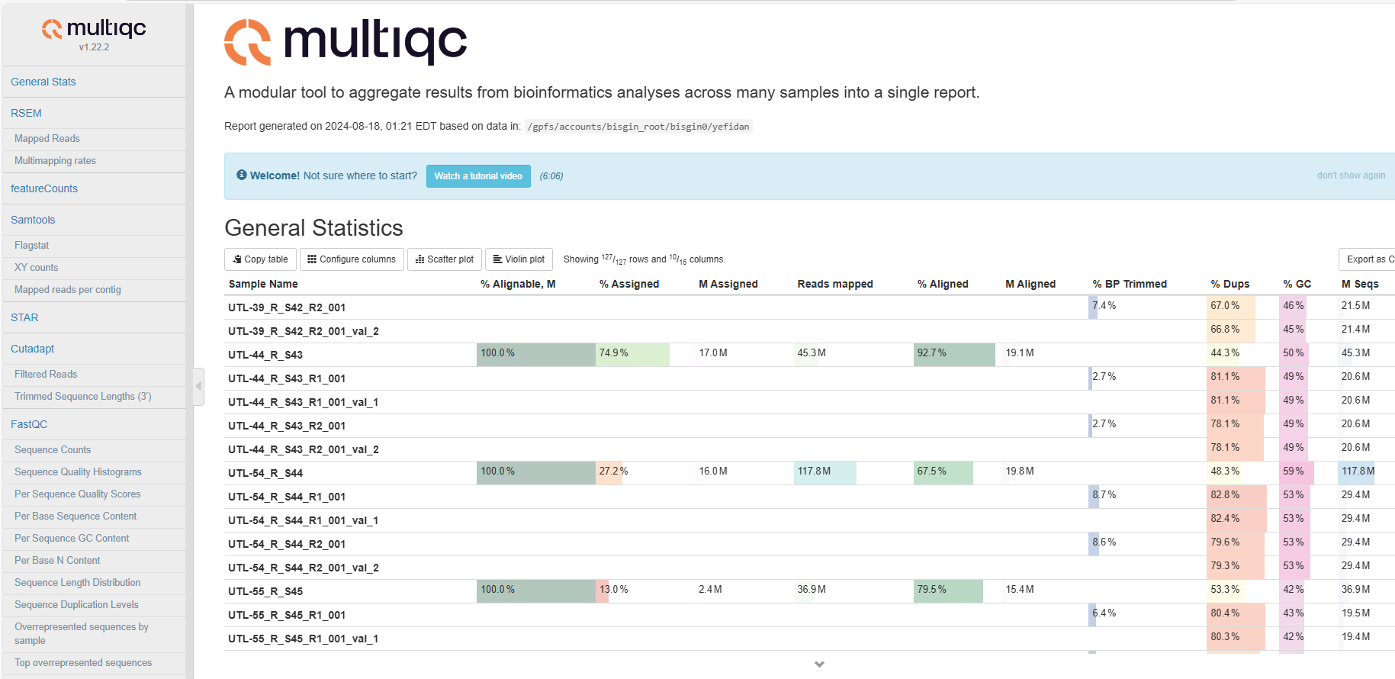

Slide 26
Then we picked the best samples according to alignment and assignment scores.
C= 27, 28, 31, 43, 48
E= 36, 41, 42, 49, 50
N= 29, 30, 37, 38, 46

Slide 27
Then we generated the count table for further analysis in R.
featureCounts -T 16 -p --countReadPairs -a ref/Homo_sapiens.GRCh38.112.gtf -o counts/gene_counts.txt aligned_data/*.bam

Slide 28
We used R for further analysis. We want to show you the rest in a Rmarkdown document.

